Slide 1

DRAINAGE FEE UPDATE
TITLE HERE
TITLE HERE
December 16, 2025

Slide 2

STRATEGIC GOAL CONNECTIONS
•Goal 5: Provide Sound Governance and Fiscal Management
•5.7 Ensure continued financial stability and accountability: Maintain financial transparency.
•Goal 6: Strengthen and Sustain Our Infrastructure
•6.2 Enhance infrastructure for economic growth: Improve competitiveness through infrastructure investments that includes collaboration with neighboring jurisdictions and exemplary peer agencies.
•6.5 Implement a funding stream for infrastructure: Establish reliable funding for continual improvements.
•6.6 Strategize for and monitor City Growth: Develop proactive responses to growth rather than reactive.
•6.7 Develop and Implement Comprehensive Road Planning and Maintenance Initiatives: Ensure safe and maintained roads for existing and new developing areas and main thoroughfares
2

Slide 3

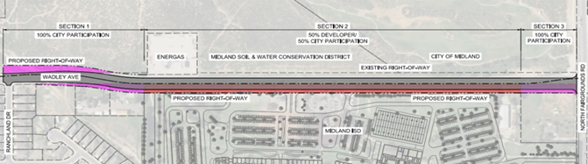
CURRENT NEEDS
$18.1 M ($6.04 M for 3-year period beginning 2027)
$4.5 M in deductions identified ($1.5 M from Water and Sewer Fund and $3 M in MISD permit fees)
$13.6 M needed for new 3-year total
January 2027​ | January 2028​ | January 2029​
$4.53 Mil​ | $4.53 Mil​ | $4.53 Mil​
Wadley Avenue
3

Slide 4
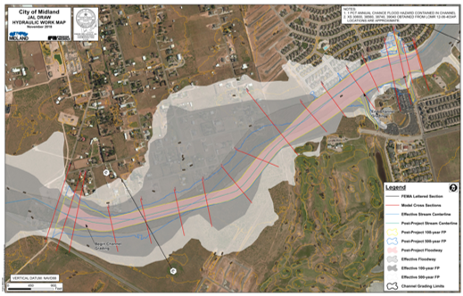
LONG-TERM NEEDS
Due to rapid growth, needs are $200M over 20 years
"Pay as you go" system
Jal Draw
4

Slide 5
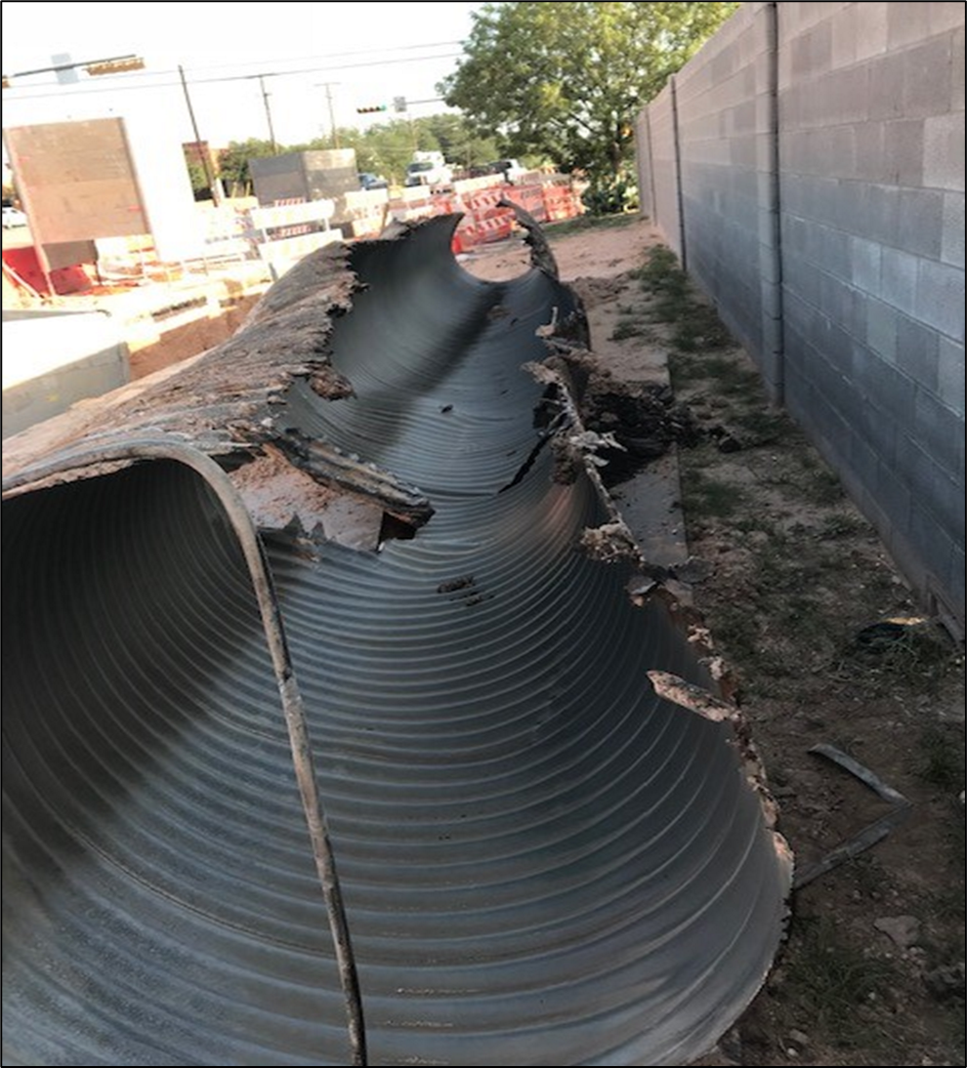
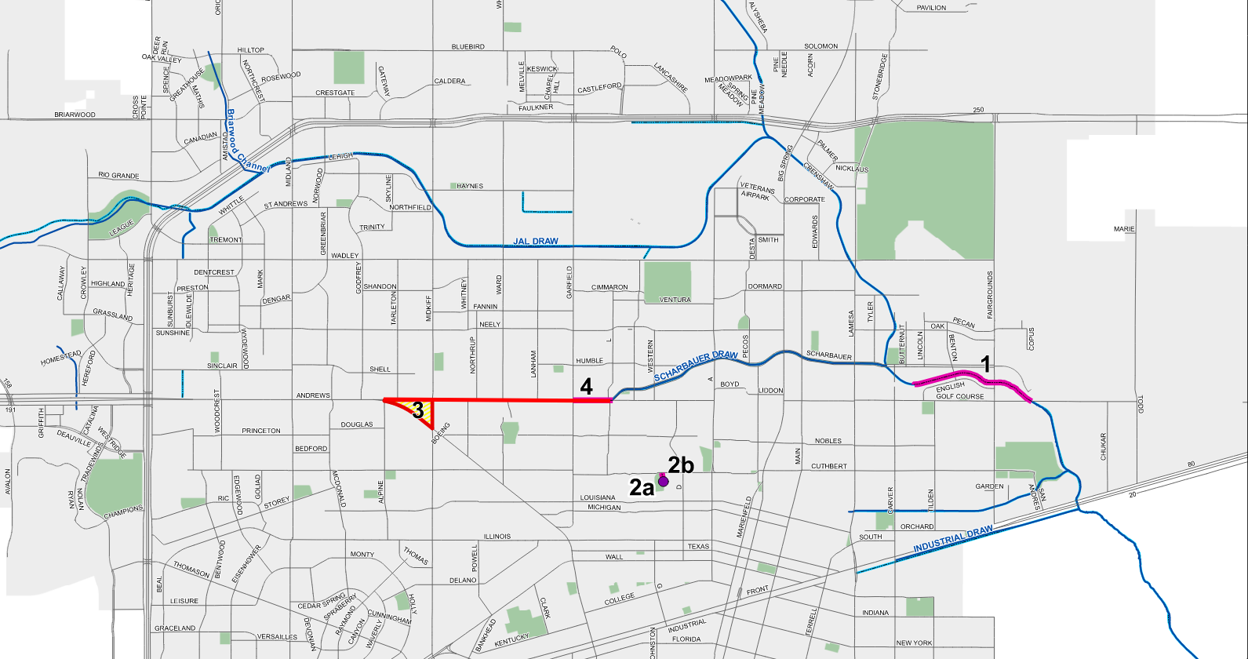
DRAINAGE FEE HISTORY
1996 Master Drainage Plan – not implemented due to lack of funds​
2007 18 projects identified – est. Costs: $73 million​ (2007 dollars)
2010 Presentation included recommended rates but no action taken
2017 Presentation - 10-year/$75 million plan
2018 Drainage Fee Established​ (rates 1/3 of recommended rates)
2023 Drainage Improvement Plan presentation – 5-yr rolling plan​
Golf Course Rd. - $20 Mil
Golf Course and Midkiff
5
Notes:
Combine benchmark

Slide 6
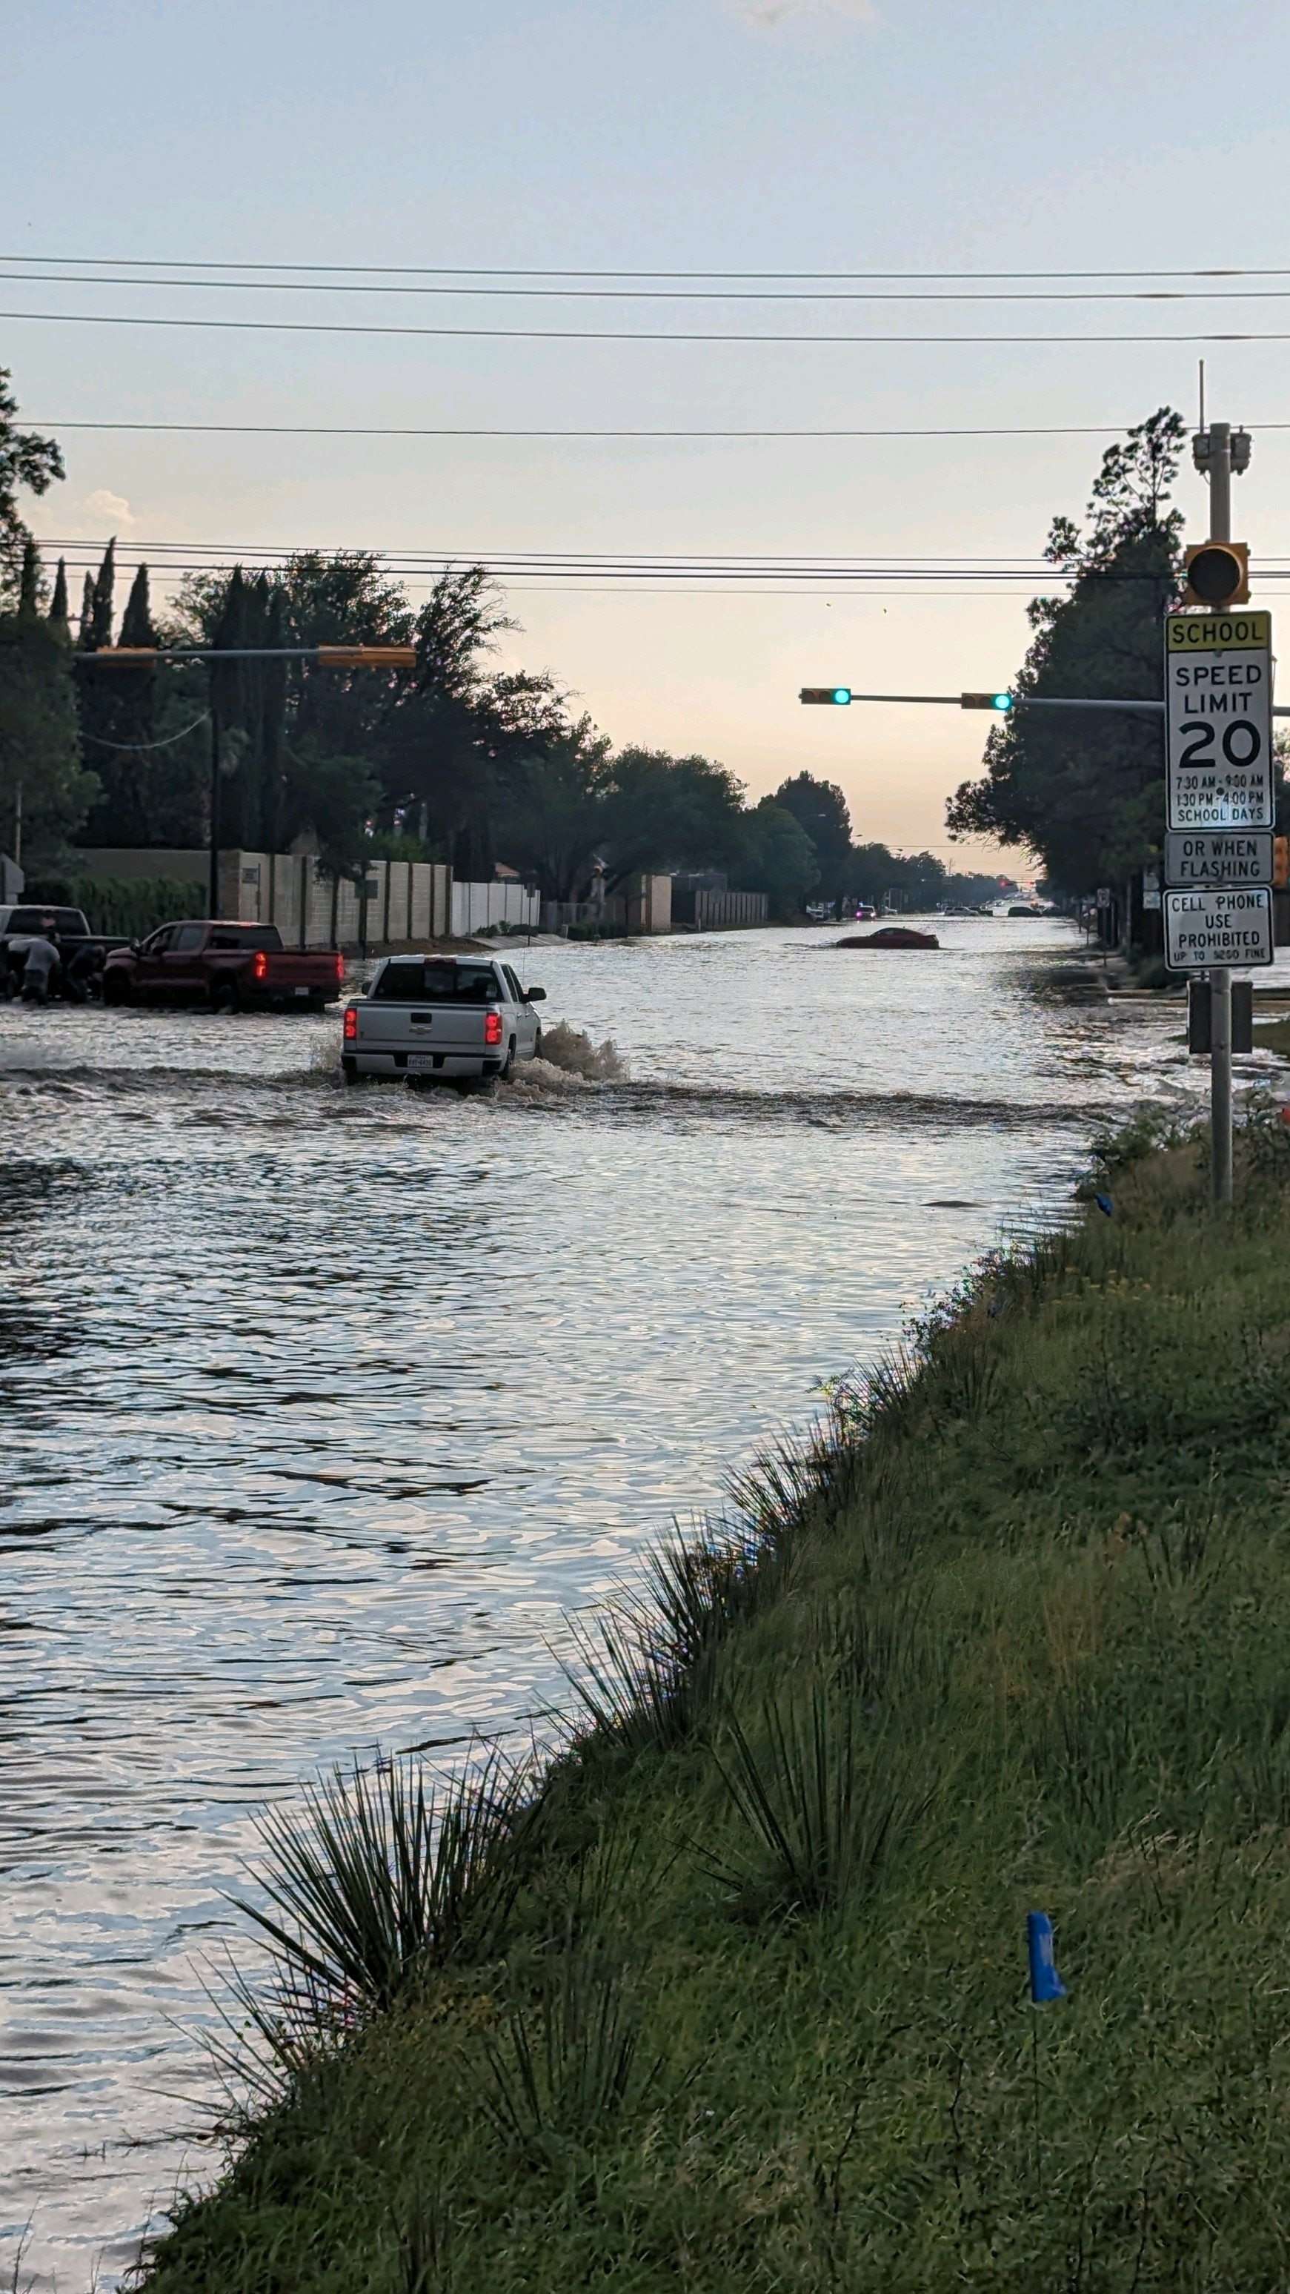
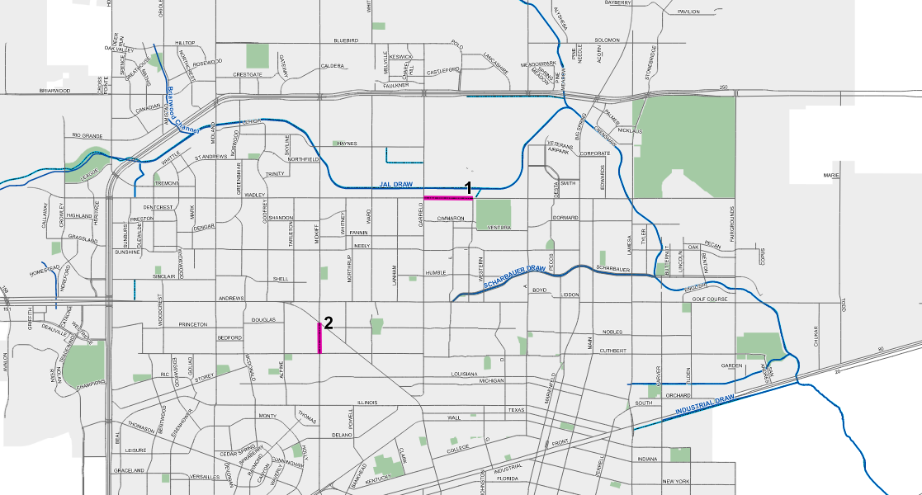
DRAINAGE FEE HISTORY
Need to address inverted roadways also identified in 5-yr rolling plan
670 Miles of Roadway
15 Miles of Inverted Roadway (Wadley, Golf Course Rd.)
Est. Costs: $110 Million
Wadley - $15 Million
6
Wadley Av
Notes:
Combine benchmark

Slide 7
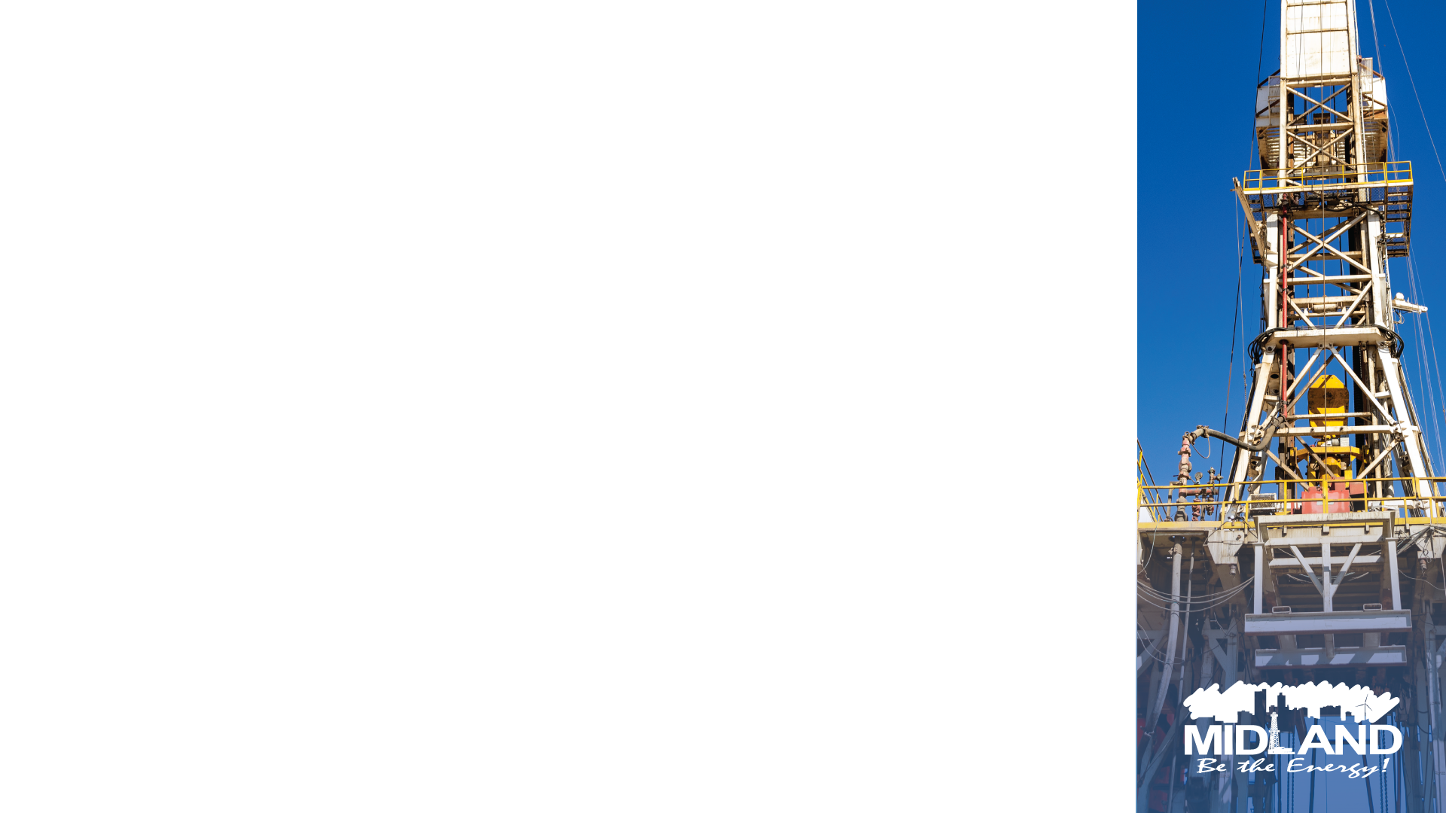
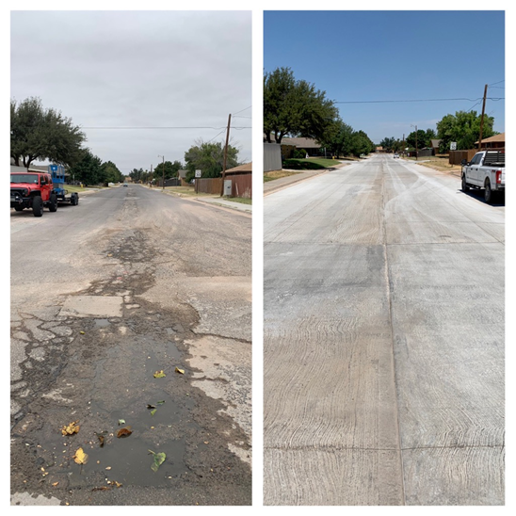
NEW RATE TIERS
 | Proposed Rate
Res Tier 1 | $2.94
Res Tier 2 | $4.90
Res Tier 3 | $8.33
Com Tier 1 | $14.21
Com Tier 2 | $31.85
Com Tier 3 | $73.50
Com Tier 4 | $167.58
Com Tier 5 | $377.30
Com Tier 6 | $539.00
Additional Revenue | Projected FY26 | Projected FY27
Drainage Fee | $3,250,000 | $4,643,136
Before
After
33% less than initial projections
7

Slide 8
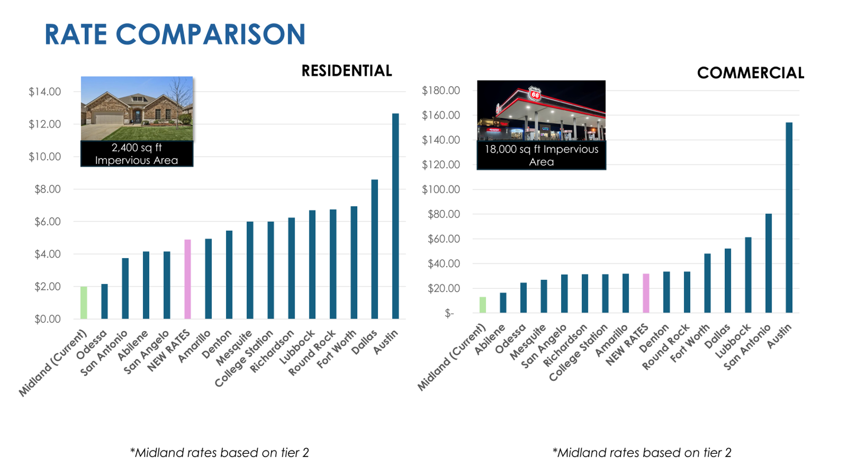
8
Notes:
Combine benchmark

Slide 9

PROPOSED SCHEDULE
November 2025 –
Publication of proposed rate ordinance (3 publications)
December 16, 2025 –
City Council Public Hearing (First Reading)
January 13, 2026 – Second Reading
February 1, 2026 – New rates effective
9

Slide 10

MISSION
Deliver exceptional services and promote a high quality of life and place for ALL our citizens.

Slide 11
BRIEF HISTORY
Flood reduction projects identified throughout the City
Need to address inverted roadways also identified
667 total miles of roadway
15 miles of inverted roads (Wadley, Golf Course)
Cost to address inverted roads - $110 Million
11
Scharbauer Draw

Slide 12

NEW RATE TIERS
 | Proposed Rate
Res Tier 1 | $2.94
Res Tier 2 | $4.90
Res Tier 3 | $8.33
Com Tier 1 | $14.21
Com Tier 2 | $31.85
Com Tier 3 | $73.50
Com Tier 4 | $167.58
Com Tier 5 | $377.30
Com Tier 6 | $539.00
Revenues | Projected FY26** | Projected FY27***
Drainage Fee | $5,500,066 | $7,374,752
 | Dollars
Added FY26 Revenue | $2,768,450
Benefits:
Uniform impact to customers
Replenishes depleted reserves
Supports added maintenance
Increases revenue for flood-related roadway repairs and reconstruction
Enables execution of stormwater CIP
**Projected FY26 is pro-rated
*** includes 1% growth in accounts
11

Slide 13
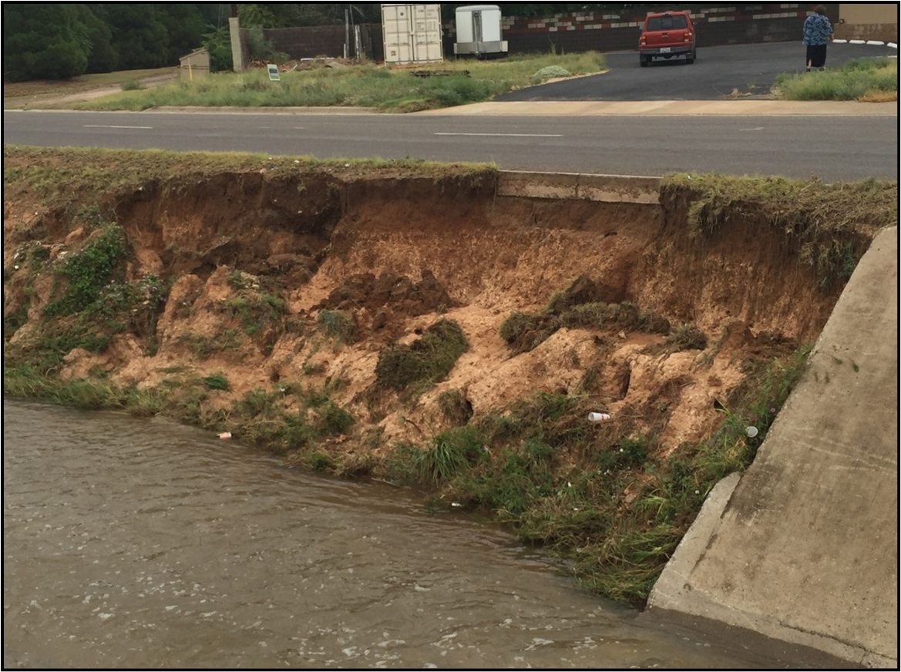
BRIEF HISTORY
1996 Master Drainage Plan – not implemented due to lack of funds
1996 Master Drainage Plan slightly implemented due to lack of funds
13
Scharbauer Draw

Slide 14
AGENDA
Drainage Fee Background
Current and Long-Term Needs
Proposed Rates
Benefits
Schedule
Scharbauer Draw
14

Slide 15

DRAINAGE FEE – 2018 RATES AND PROJECTED REVENUE
 | Impervious Area* | Monthly Rate
Res Tier 1 | 0-1,399 | $1.20
Res Tier 2** | 1,400-2,424 | $2.00
Res Tier 3 | 2,425+ | $3.40
Com Tier 1 | 0-8,339 | $5.80
Com Tier 2 | 8,340-18,702 | $13.00
Com Tier 3 | 18,703-47,853 | $30.00
Com Tier 4 | 47,854-92,740 | $68.40
Com Tier 5 | 92,741-261,475 | $154.00
Com Tier 6 | 261,476+ | $220.00
Res - $1.1M (50%) | Com - $1.1M (50%) | Total - $2.2M
*Specifically, square footage of rooftop
**Tier 2 properties per Ordinance-9753 = 1.00 ERU
15

Slide 16

DRAINAGE SYSTEM SUCCESSES
Operations & Maintenance
Capital Projects
Street sweeping
Gutter and drainage system cleaning
Water quality protection
Midland Draw Widening
Mayfield Addition Detention Pond
Jal Draw
Road Bond Projects
Key Performance Indicator | FY2022 Actual | FY2023 Actual | FY 2024 Actual | FY 2025 Target
Linear footage of storm drainpipe cleaned | 13,469 | 15,597 | 24,016 | 18,000
8

Slide 17
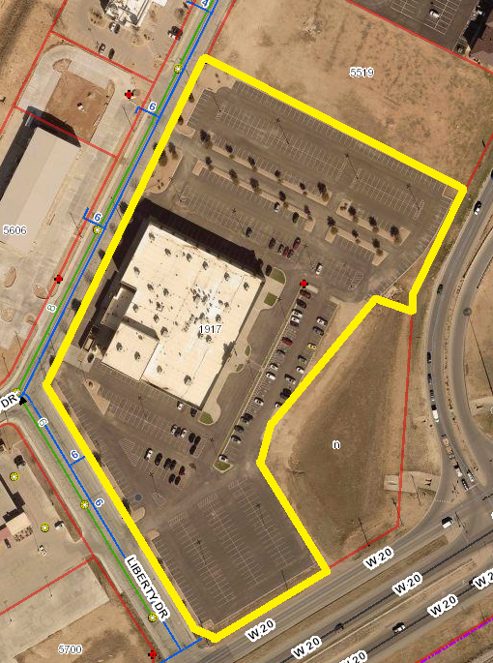
CURRENT COMMERCIAL TIER 6 EXAMPLE
1917 Liberty Dr.
Cinergy
Approx. 310,505
impervious sf
Current fee: $220.00
7

Slide 18
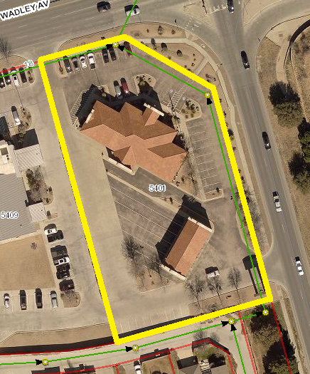
CURRENT COMMERCIAL TIER 4 EXAMPLE
5401 W. Wadley Ave.
West Texas National Bank
Approx. 55,478 impervious sf
Current fee: $68.40
18

Slide 19
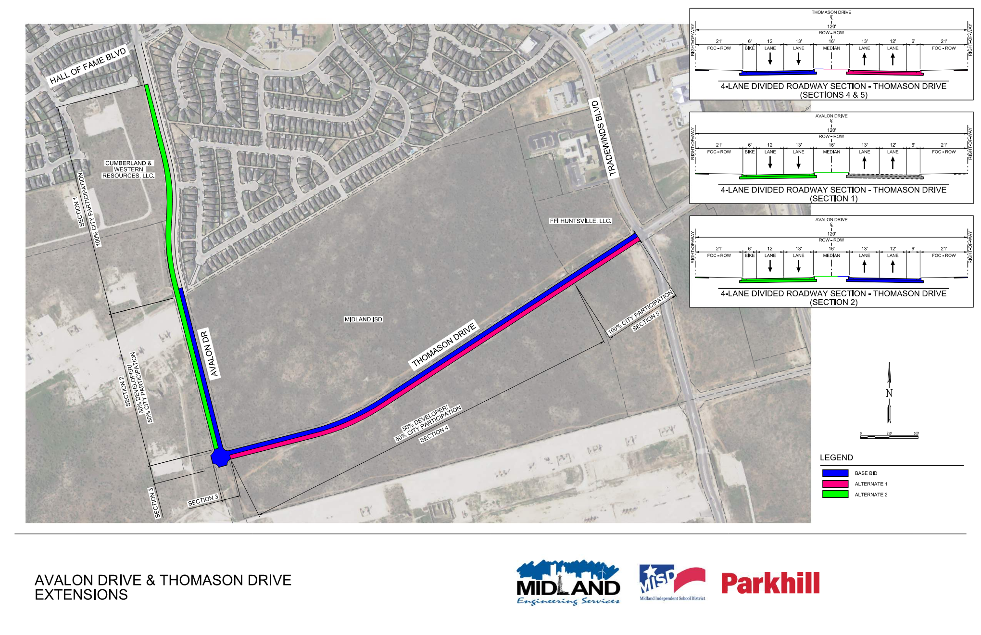
AVALON AND THOMASON
19
Notes:
Combine benchmark

Slide 20
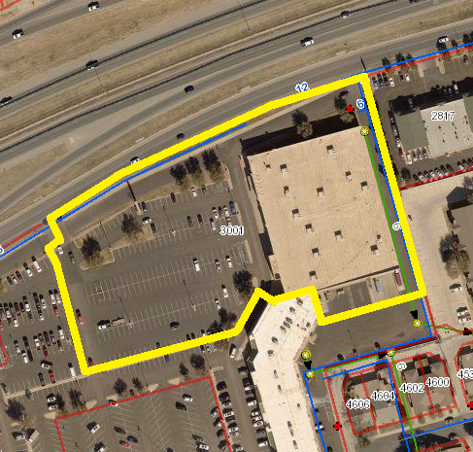
CURRENT COMMERCIAL TIER 5 EXAMPLE
3001 W. Loop 250
Burlington Coat Factory
Approx. 188,181
impervious sf
Current fee: $154.00
6

Slide 21

Recommendations
Adopt FY26 mid-year adjustment to drainage rates to provide sufficient revenue to rebuild operating reserve and phase in increased funding for improvements
Complete cost of service study for stormwater services and CIP needs
Evaluate rate structure to ensure equitable distribution of costs
Assess impact of current exemptions and recommend alternatives

Slide 22
Exemptions
Among a sample of 50 Texas cities with stormwater fees:
10 exempted religious properties
28 exempted city properties
14 exempted county properties
19 exempted ISD properties
City | Religious Exempt | City Exempt | County Exempt | ISD Exempt
El Paso | No | No | No | Yes
Denton | No | No | No | No
Round Rock | No | Yes | Yes | Yes
Abilene | No | No | No | No
College Station | No | Yes | No | Yes
Mansfield | No | Yes | Yes | Yes
22
Notes:
Combine benchmark

Slide 23

Optional Exemptions
Revenue Not Collected Last Year Due to Optional Exemptions
MISD | CITY OF MIDLAND | MIDLAND COUNTY
$94,740 | $205,608 | $42,984
RELIGIOUS ORGANIZATIONS | STATE OF TEXAS | CEMETERIES
$108,480 | $14,820 | $4,488
Total: $471,120
23

Slide 24
2018 vs. 2025 Volumes
24

Slide 25
Services Eligible for SW Funding
Compliance
Maintenance
Capital
System inventory
MS4 permit administration
Site inspections
Outfall inspections
BMP implementation
Plan reviews
Public engagement
Water quality management
Street sweeping
General administration
System inspections
Household hazardous waste collection
Inlet/conveyance debris removal
Channel repair
Vegetation management
Hazardous spill management
Aeration and aquatic vegetation management
Flood control
Creek sediment removal
Erosion protection
Channel rehabilitation
Channel reconstruction
Repair/reconstruction of roadway at flood prone areas
Bridge and culvert construction
25

Slide 26
2018 vs. 2025 Revenue
26

Slide 27
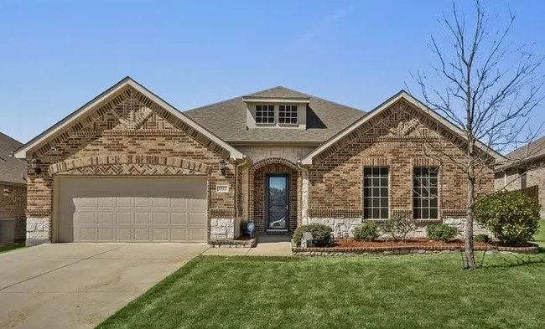
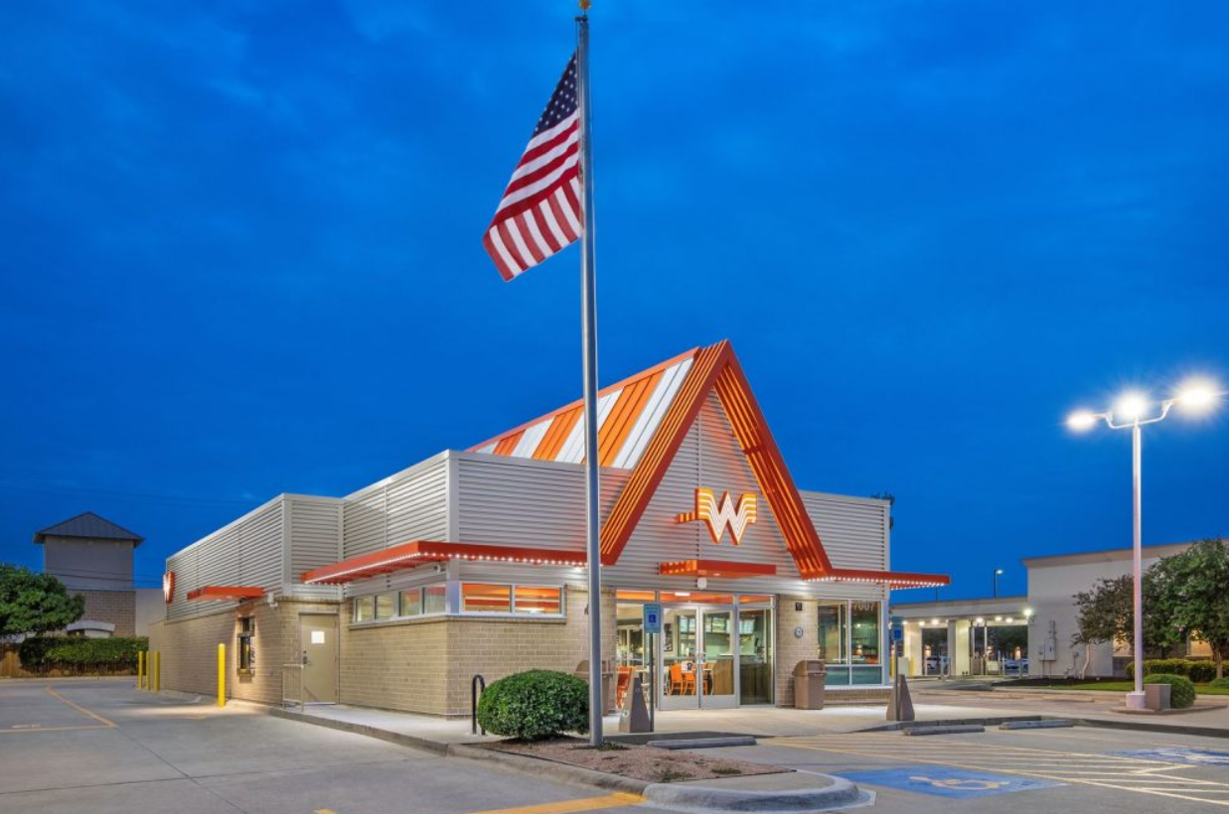
Rate Comparison
2,400 sq ft Impervious Area
25,000 sq ft Impervious Area
27
*Midland rates based on tier 2
*Midland rates based on tier 3
Notes:
Combine benchmark

Slide 28
Rate Comparison
28
* Midland residential rates based on tier 2
**Midland commercial rates based on tier 3
Notes:
Combine benchmark

Slide 29
Rate Comparison
29
* Midland residential rates based on tier 2
**Midland commercial rates based on tier 3
Notes:
Combine benchmark

Slide 30
FY26 Rates and Projected Revenue
 | Monthly Rate* | Property Count | FY26 Revenue Projection
Res Tier 1 | $1.20 | 3,171 | $45,662
Res Tier 2 | $2.00 | 12,487 | $299,688
Res Tier 3 | $3.40 | 24,240 | $988,992
TOTAL |  | 38,898 | $1,334,342
Com Tier 1 | $5.80 | 646 | $44,962
Com Tier 2 | $13.00 | 690 | $107,640
Com Tier 3 | $30.00 | 773 | $278,280
Com Tier 4 | $68.40 | 383 | $314,366
Com Tier 5 | $154.00 | 262 | $484,176
Com Tier 6 | $220.00 | 142 | $374,880
TOTAL |  | 2,896 | $1,604,304
GRAND TOTAL |  |  | $2,938,646
Revenues | Adopted FY26
Drainage Fee | $2,731,616
 | Dollars
Surplus/(Deficit) | $207,030
30

Slide 31
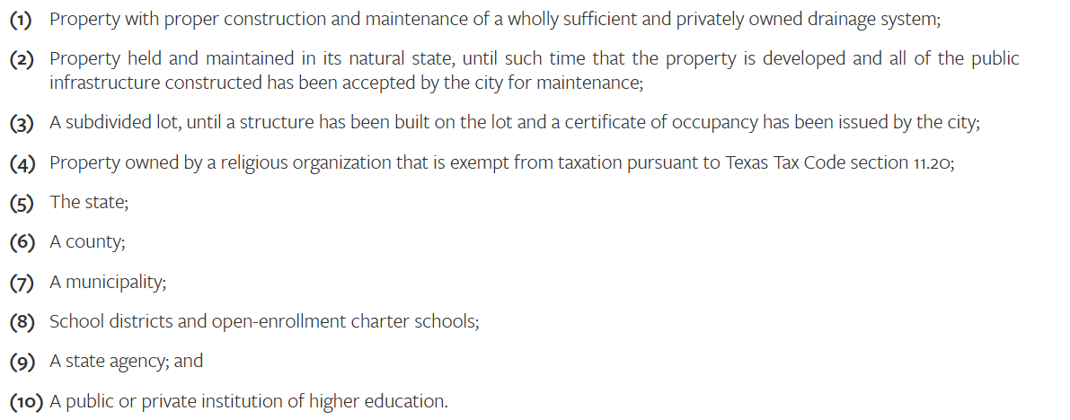
Stormwater Utility Fee Background
Rates established in April 2018 in accordance with Texas Local Government Code 552
Funds drainage
services and infrastructure
The following property types are exempt from the fee:
31

Slide 32
Current and Recommended Rates Comparison
 | Current Rates
Res Tier 1 | $1.20
Res Tier 2 | $2.00
Res Tier 3 | $3.40
Com Tier 1 | $5.80
Com Tier 2 | $13.00
Com Tier 3 | $30.00
Com Tier 4 | $68.40
Com Tier 5 | $154.00
Com Tier 6 | $220.00
 | Recommended Rates
Res Tier 1 | $2.94
Res Tier 2 | $4.90
Res Tier 3 | $8.33
Com Tier 1 | $14.21
Com Tier 2 | $31.85
Com Tier 3 | $73.50
Com Tier 4 | $167.58
Com Tier 5 | $377.30
Com Tier 6 | $539.00
32

Slide 33
Option 1 – Fund Current Needs and Additional CIP
January 2027 | January 2028 | January 2029
$4.53 Mil | $4.53 Mil | $4.53 Mil
 | Proposed Rate
Res Tier 1 | $3.50
Res Tier 2 | $5.85
Res Tier 3 | $9.95
Com Tier 1 | $16.96
Com Tier 2 | $38.05
Com Tier 3 | $87.75
Com Tier 4 | $200.05
Com Tier 5 | $450.45
Com Tier 6 | $643.50
 | Dollars
Added FY26 Revenue | $3,641,305
Benefits:
Uniform impact to customers
Replenishes depleted reserves
Supports added maintenance
Increases revenue for flood-related roadway repairs and reconstruction
Enables execution of additional stormwater CIP
*Rates rounded to nearest $0.05
**Projected FY26 is pro-rated
*** includes 1% growth in accounts
10

Slide 34
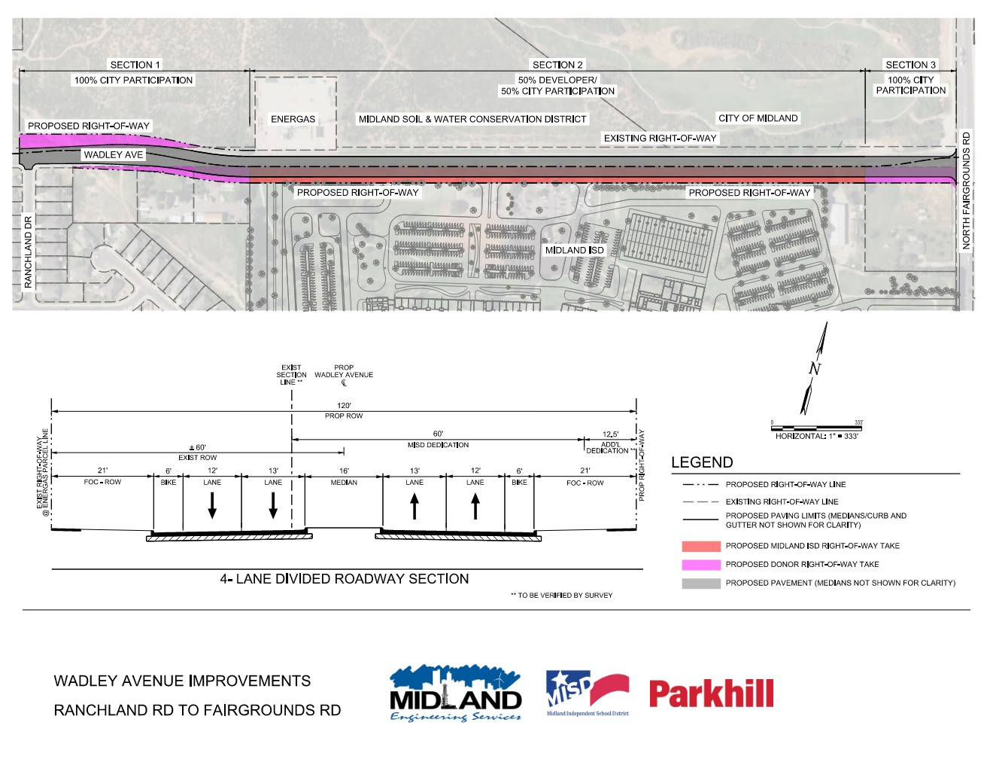
WADLEY AVENUE
34
Notes:
Combine benchmark

Slide 35
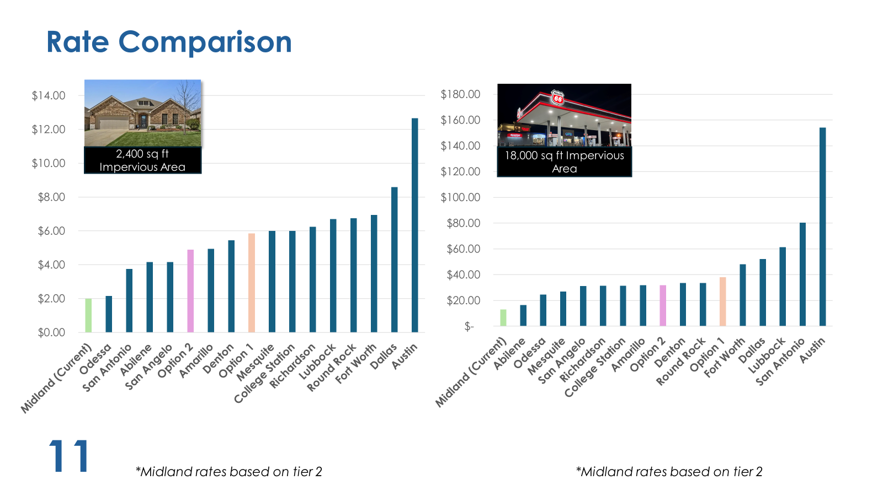

Rate Comparison
35
* Midland residential rates based on tier 2
**Midland commercial rates based on tier 3
Notes:
Combine benchmark

