Slide 1
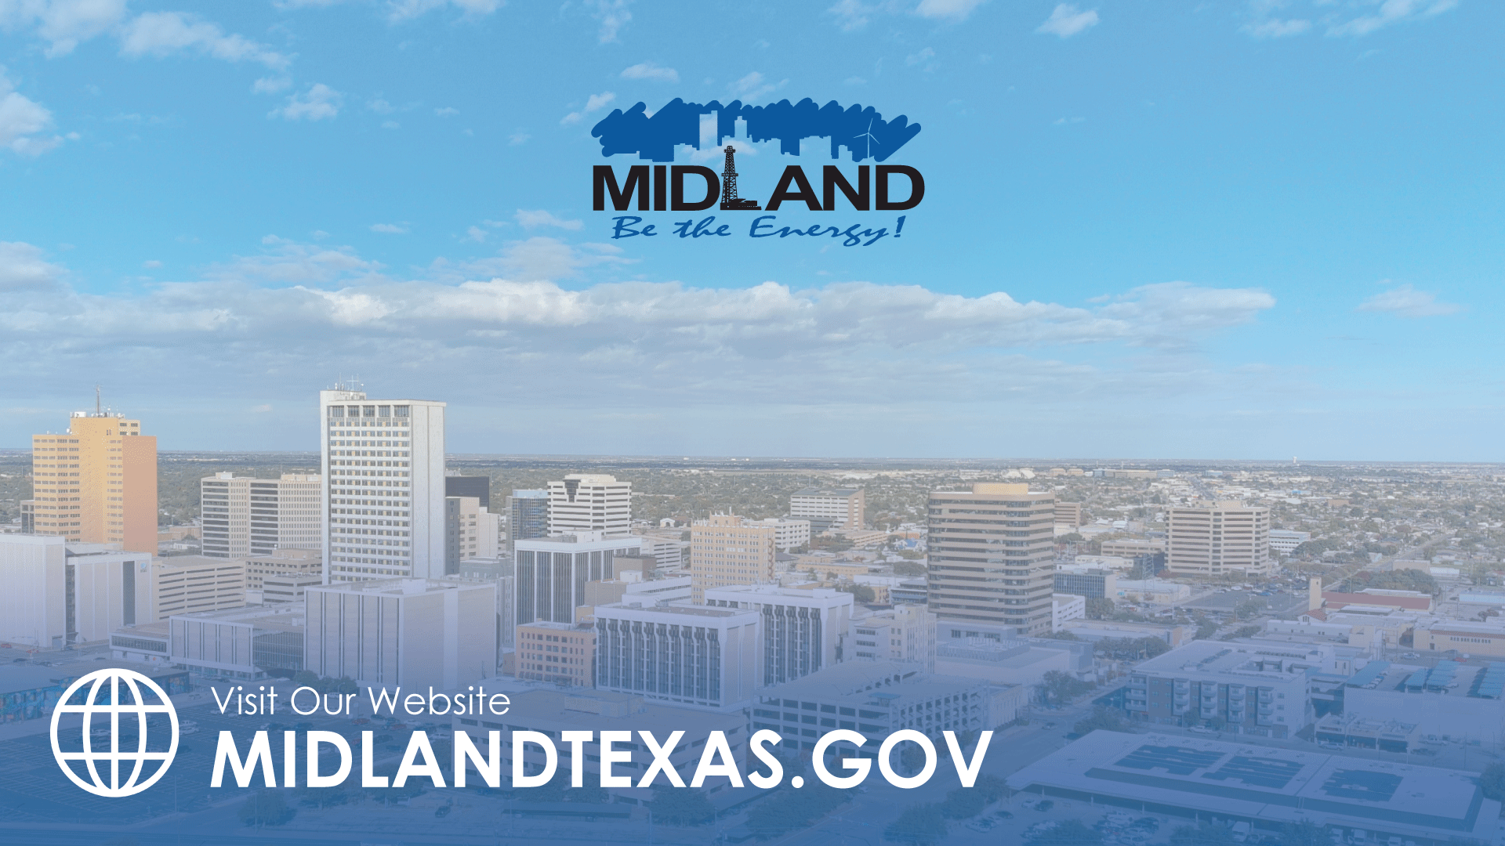
DRAINAGE NEED UPDATE
TITLE HERE
TITLE HERE
JANUARY 27, 2026

Slide 2

STRATEGIC GOAL CONNECTIONS
Goal 6: Strengthen and Sustain Our Infrastructure
6.2 Enhance infrastructure for economic growth: Improve competitiveness through infrastructure investments that includes collaboration with neighboring jurisdictions and exemplary peer agencies.
6.5 Implement a funding stream for infrastructure: Establish reliable funding for continual improvements.
6.6 Strategize for and monitor City Growth: Develop proactive responses to growth rather than reactive.
6.7 Develop and Implement Comprehensive Road Planning and Maintenance Initiatives: Ensure safe and maintained roads for existing and new developing areas and main thoroughfares
2
Notes:
Effort to keep up with growth and address backlogged/neglected work

Slide 3
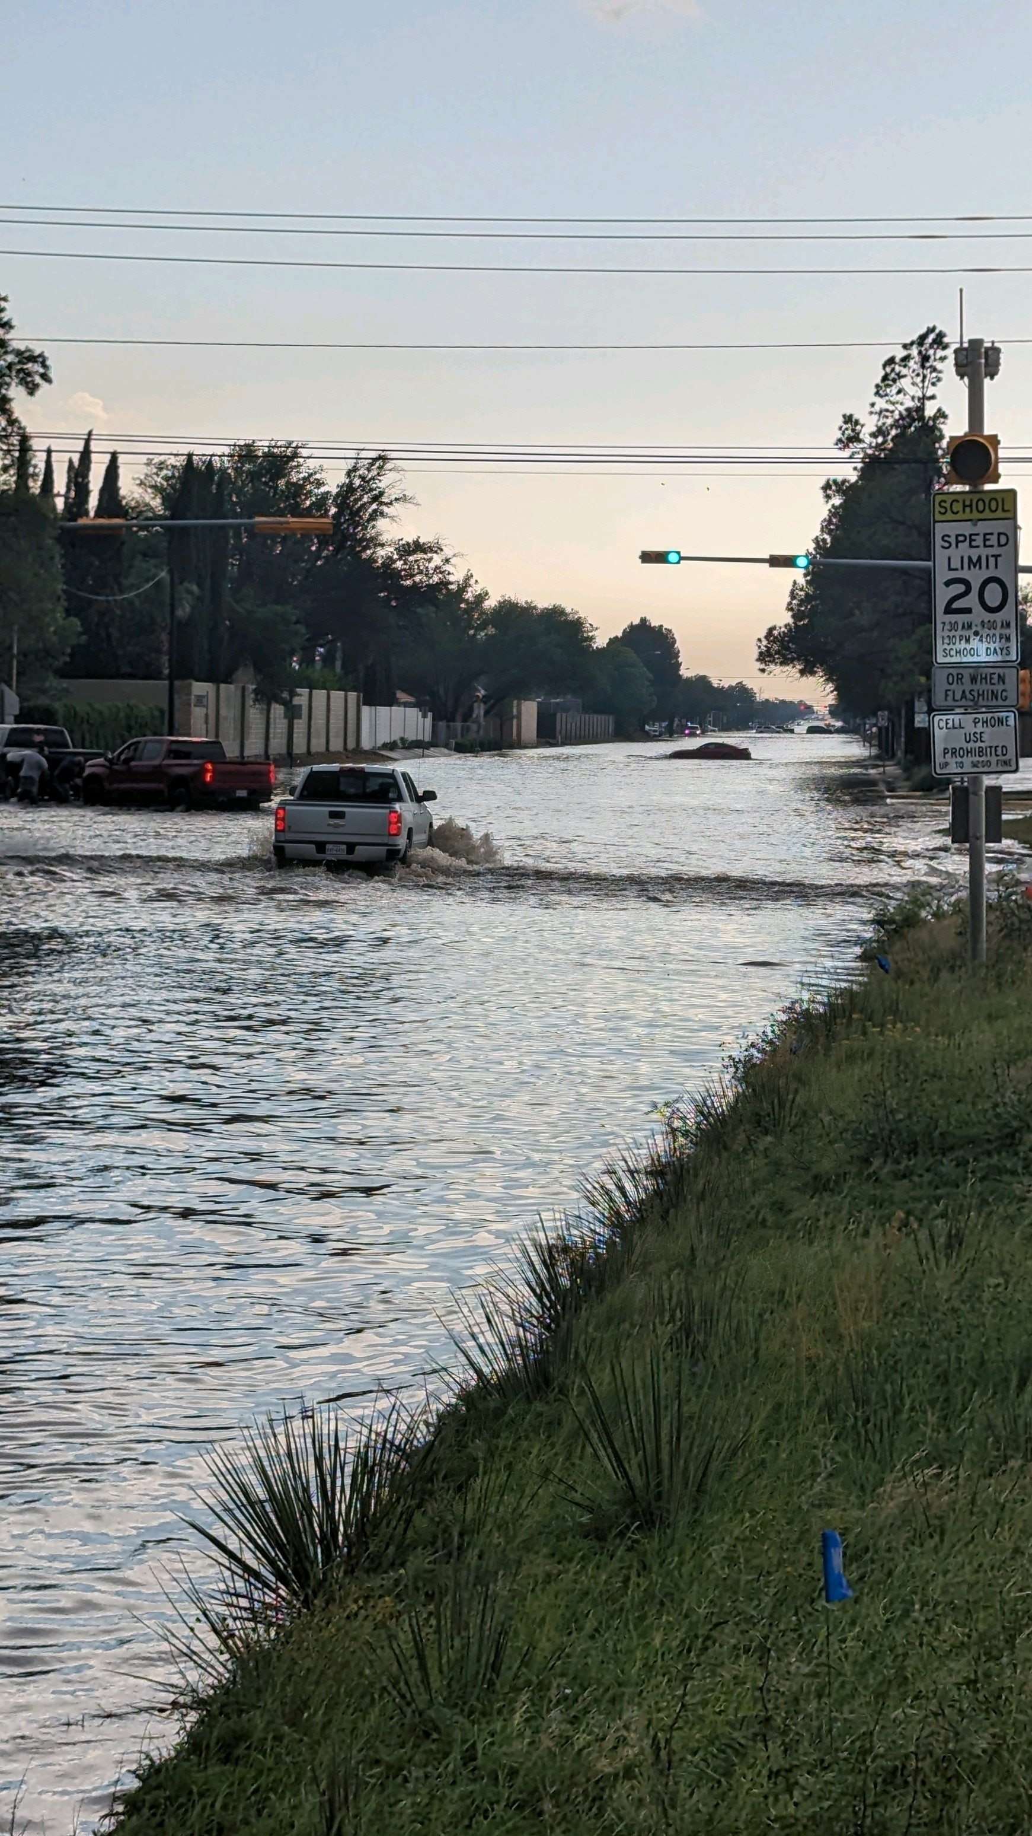
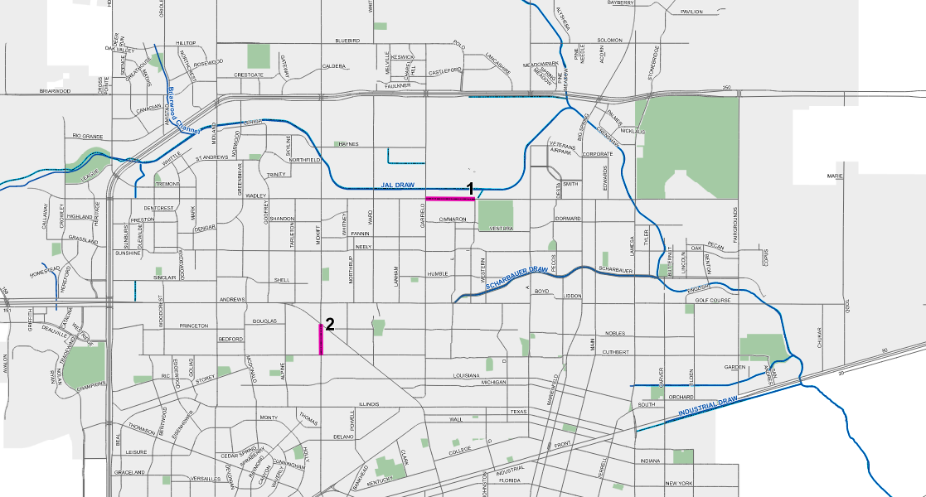
DRAINAGE BACKLOG HISTORY
1996 Master Drainage Plan – not implemented due to lack of funds​
2007 18 projects identified – est. Costs: $73 million​ (2007 dollars)
2010 Presentation included recommended rates, but no action taken
2017 Presentation - 10-year/$75 million plan
2018 Drainage Fee Established​ (rates 1/3 of recommended rates)
2023 Drainage Improvement Plan presentation – 5-yr rolling plan​
WADLEY
Golf Course and Midkiff
3
WADLEY AVE.
Notes:
Combine benchmark
30-year conversation

Slide 4
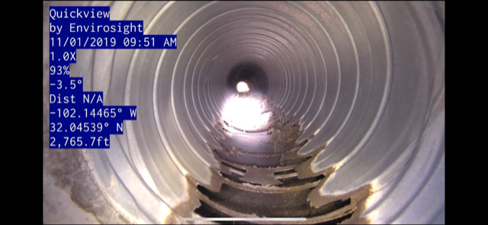
DRAINAGE FEE ACCOMPLISHMENTS
Total Revenue collected since 2018 inception:
$17.3 Million (approx. $2 Million annually)
CORRODED STORM DRAINPIPE
Completed Project Locations
Midland Draw (Golf Course to Bus. 20)
Jal Draw Earthwork (Phase 1)
Storm Drain Replacement at various roads
Valley Gutters, Pumps, Culvert Maint.
Roadway Design (Wadley and Golf Course)
Acquisition of Land
Wood Drive Improvements
Emergency Repair (Midkiff and Golf Course)
Idlewilde and Wydewood Basin Project
MOCKINGBIRD LANE – INSTALLED 1993
4
Notes:
Combine benchmark
Emphasize work at Midkiff and Golf Course

Slide 5
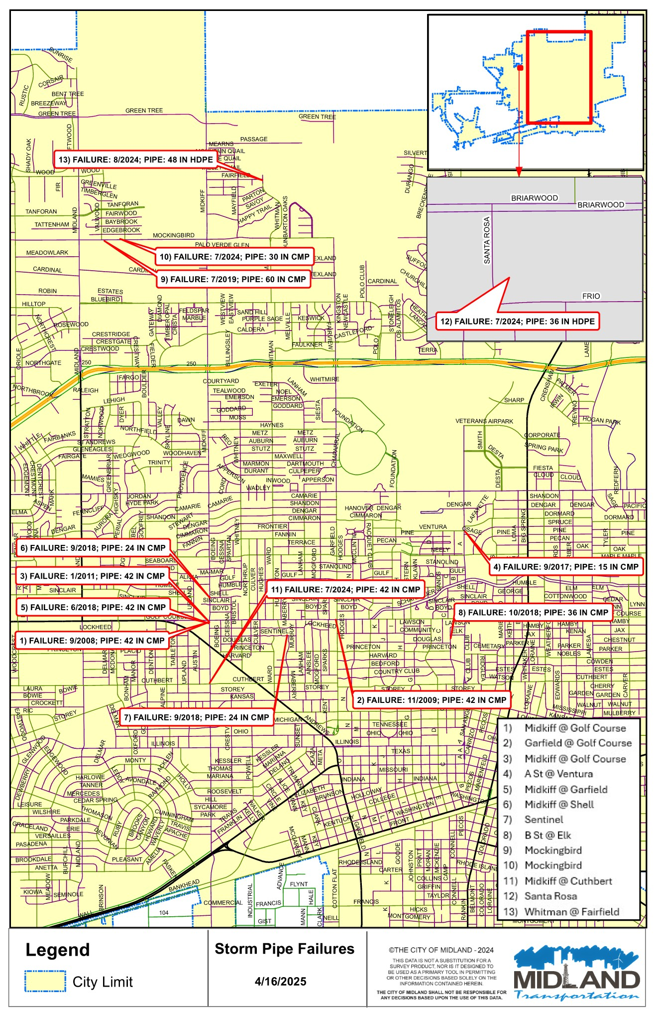
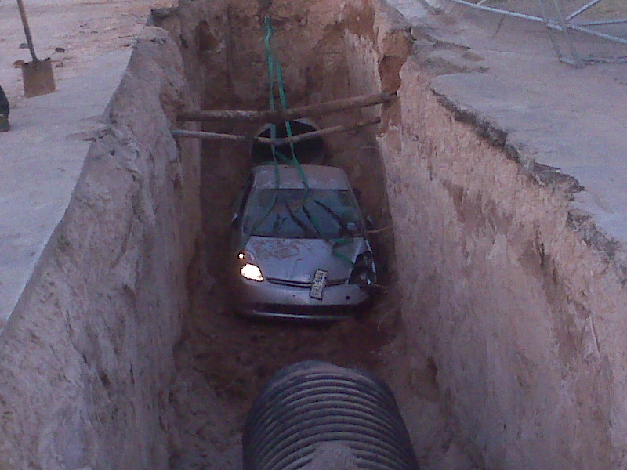
CONSEQUENCES OF NEGLECT
GARFIELD & GOLF COURSE
Notes:
13 sinkholes in 16 years

Slide 6
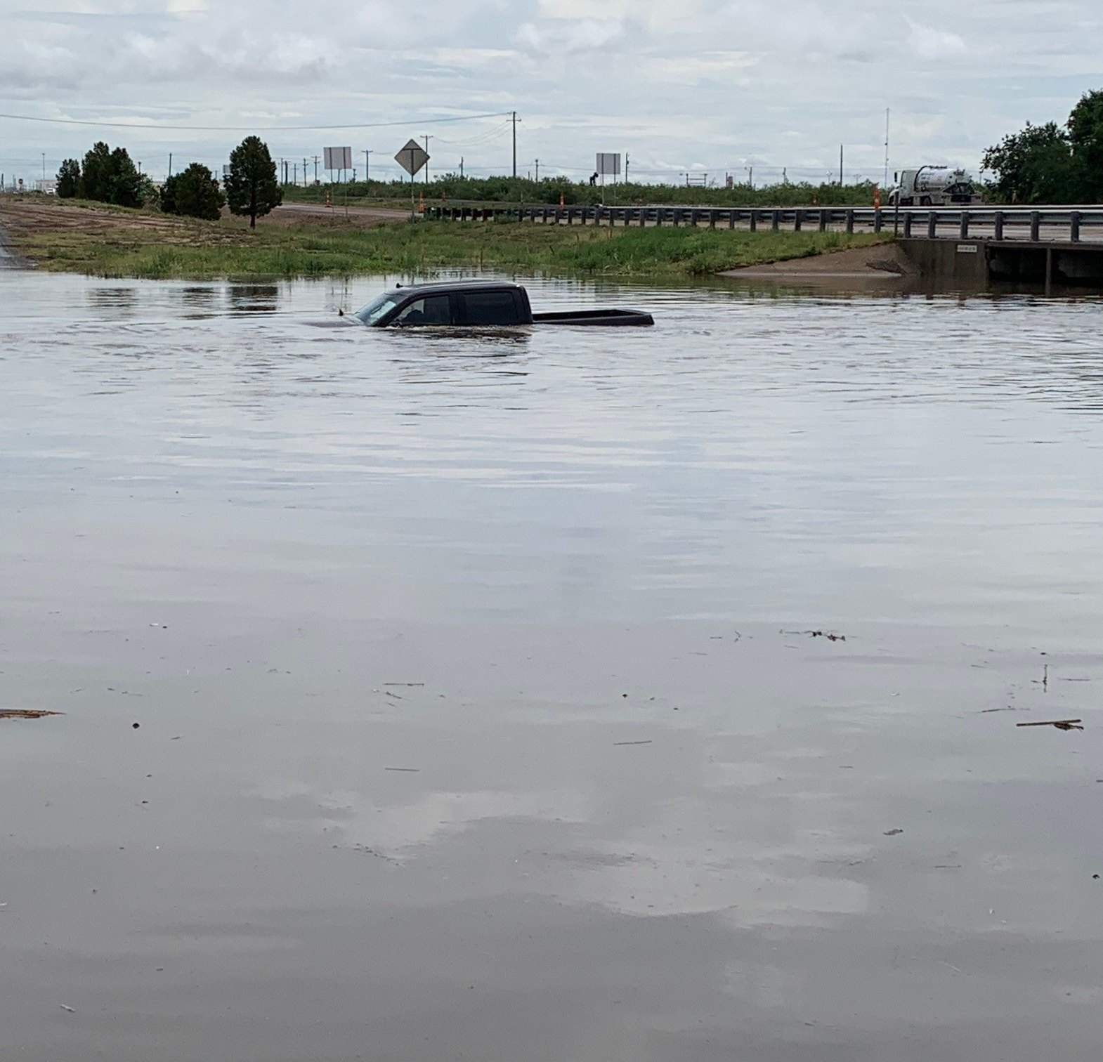
NEGLECTED DRAINAGE PROJECTS
Project Location | Estimated Cost
Wadley Improvements | $12 Million
Golf Course Road Improvements | $8.7 Million
Midkiff Road Improvements | $1.2 Million
Jal Draw Expansion (Phase 2) | $2 Million
Midland Draw Improvements | $10 Million
Ventura and Tumbleweed Park | $2.4 Million
A Street (Harvard to Scharbauer) | $1.65 Million
Neely and Humble Improvements | $1.8 Million
Terrell Improvements | $2.25 Million
B Street Improvements | $500 Thousand
Evening Star Crossing | $4 Million
Wadley/Avalon & Thomason | $13.5 Million
Total | $60 Million
MIDLAND DRAW
Golf Course and Midkiff
6
Golf Course and Midkiff
Notes:
Combine benchmark

Slide 7
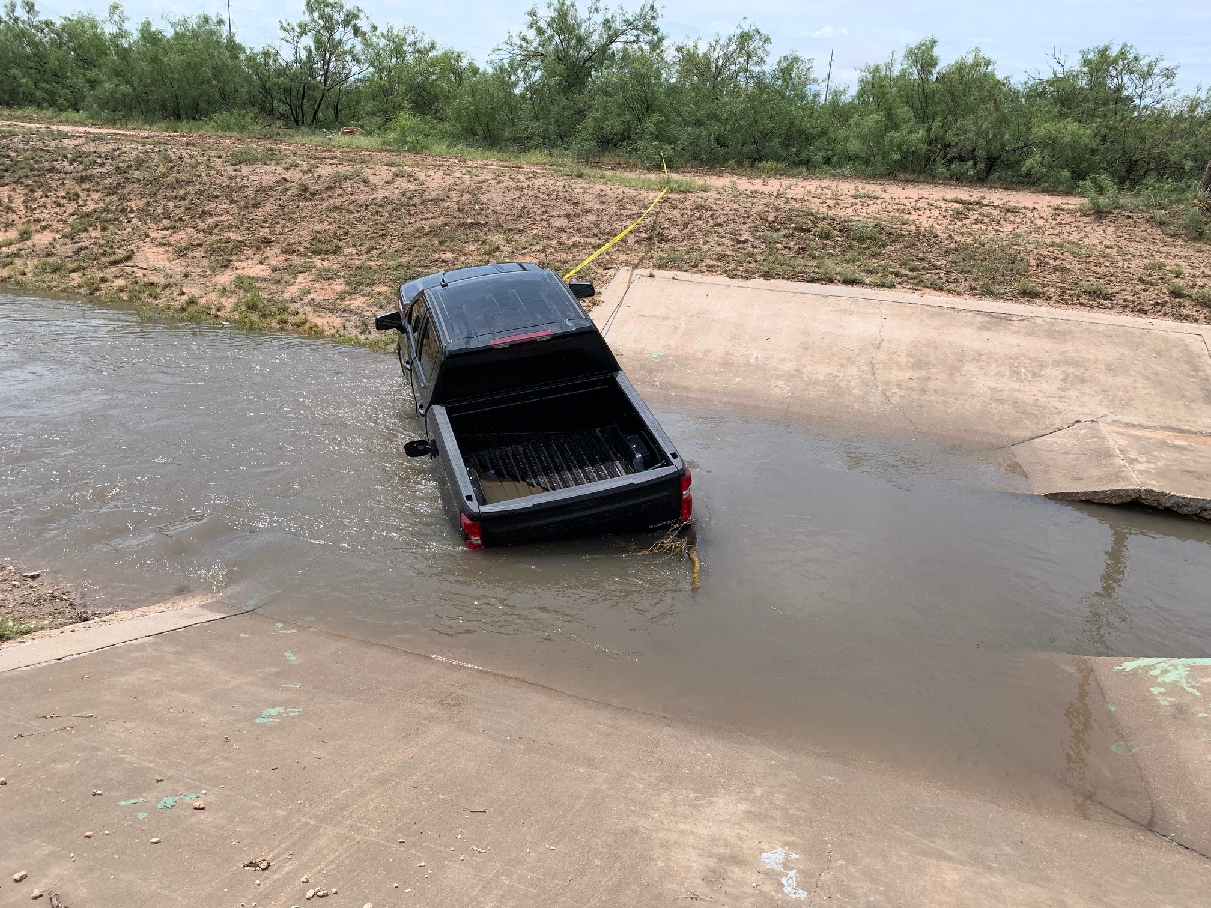
FUTURE IMPROVEMENTS
Project Location | Estimated Cost
Jal Draw (Phase 3) | $6 Million
Scharbauer Draw | $4 Million
Industrial Channel/Basin | $2 Million
Mulberry Channel | $1.5 Million
Replace CMP | $18 Million
Inverted Roadways | $22.5 Million
Airpark/Loop 250 | $6 Million
IH-20 Retention Basins | $5 Million
Annual O&M – 10 years | $10 Million
Total | $75 Million
Golf Course and Midkiff
Midland Draw
7
Notes:
Combine benchmark

Slide 8
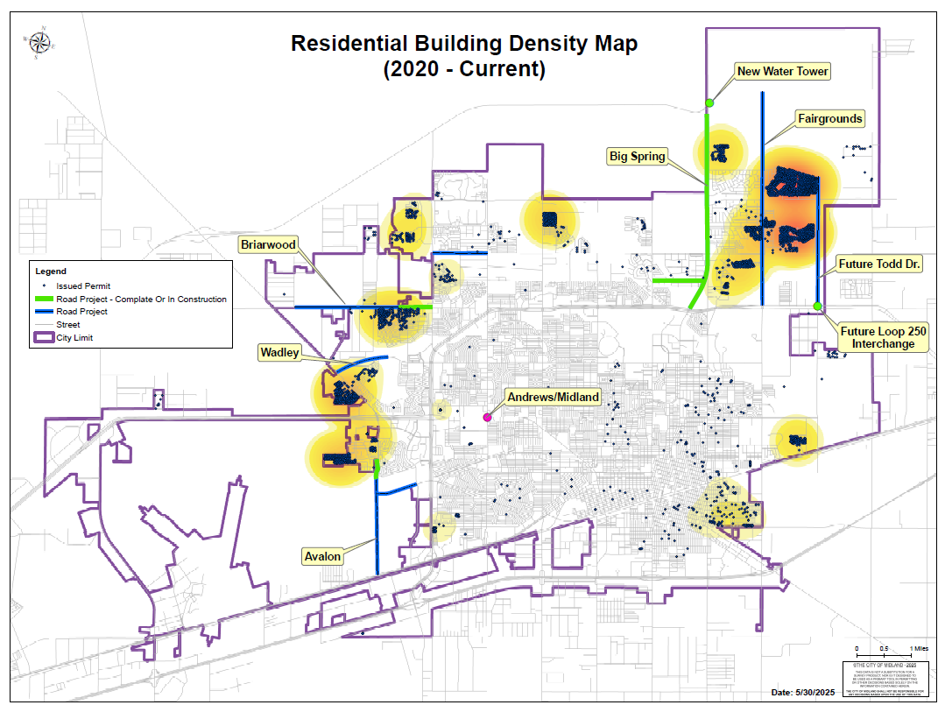
FUNDING NEEDS FOR TEN YEARS
$135 MILLION
Due to rapid growth, and to avoid more backlogged work, needs are $200M over 20 years
Golf Course and Midkiff
Scharbauer Draw
8
Notes:
Combine benchmark

Slide 9
PROPOSED DRAINAGE FEE CHANGES
Tier | Impervious Area (Sq. Feet) | Current Monthly Rate | Proposed Monthly Rate | Monthly Difference
Residential Tier 1 | 0-1,399 SF | $1.20 | $2.94 | $1.74
Residential Tier 2 | 1,400-2,424 | $2.00 | $4.90 | $2.90
Residential Tier 3 | 2,425+ | $3.40 | $8.33 | $4.93
Commercial Tier 1 | 0-8,339 | $5.80 | $14.21 | $8.41
Commercial Tier 2 | 8,340-18,702 | $13.00 | $31.85 | $18.85
Commercial Tier 3 | 18,703-47,853 | $30.00 | $73.50 | $43.50
Commercial Tier 4 | 47,854-92,740 | $68.40 | $167.58 | $99.18
Commercial Tier 5 | 92,741-261,475 | $154.00 | $377.30 | $223.30
Commercial Tier 6 | 261,476+ | $220.00 | $539.00 | $319.00
*Drainage fees at current and proposed levels is not sufficient to cover all needs. A blended funding source with drainage fees is required to accomplish long-term goals and needs.
*Proposed effective Feb. 1, 2026
Golf Course and Midkiff
Scharbauer Draw
9
Golf Course and Midkiff
Notes:
Combine benchmark

Slide 10

MISSION
Deliver exceptional services and promote a high quality of life and place for ALL our citizens.

Slide 11
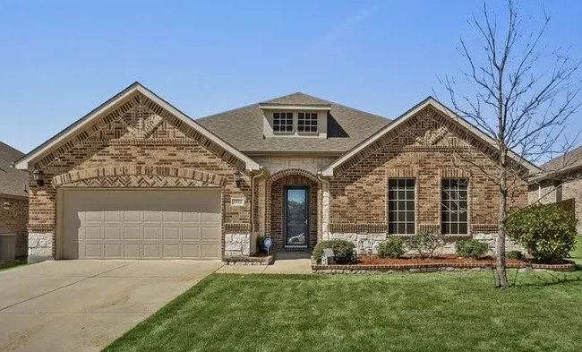
Residential Rate Comparison
2,400 sq ft Impervious Area
11
*Midland rates based on tier 2
Notes:
Com Tier 2 + Add’l Cities

Slide 12
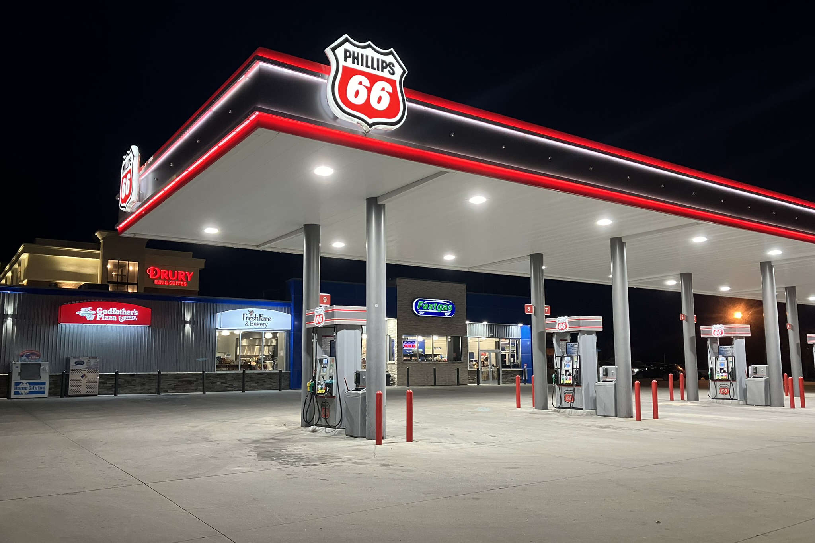
Commercial Rate Comparison
18,000 sq ft Impervious Area
12
*Midland rates based on tier 2
Notes:
Com Tier 2 + Add’l Cities

Slide 13
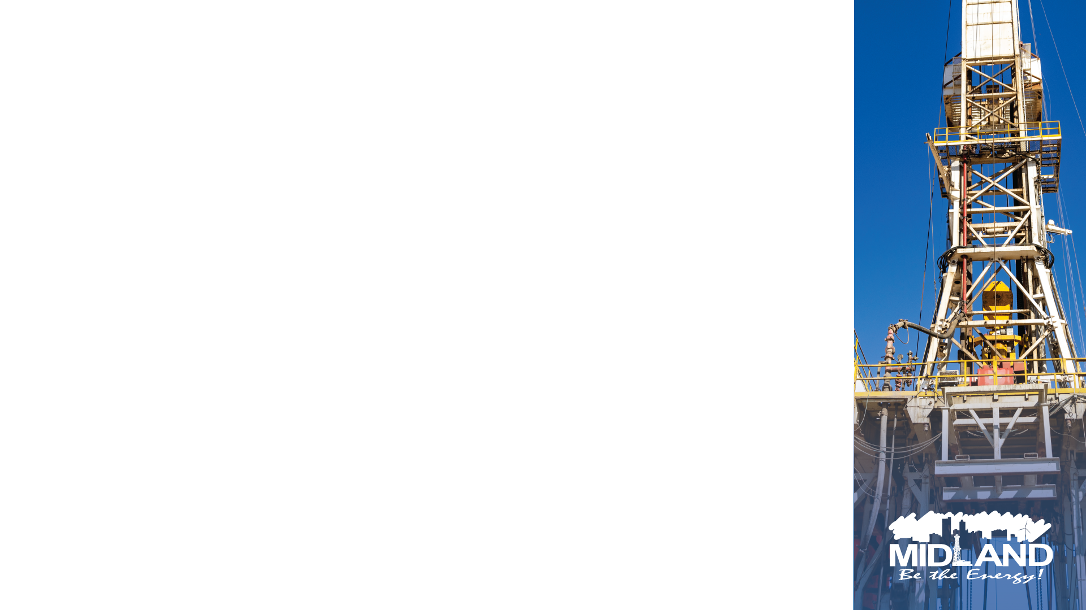
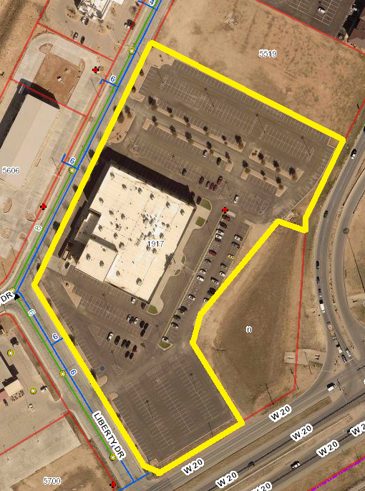
CURRENT COMMERCIAL TIER 6 EXAMPLE
1917 Liberty Dr.
Cinergy
Approx. 310,505
impervious sf
Current fee: $220.00
7

Slide 14
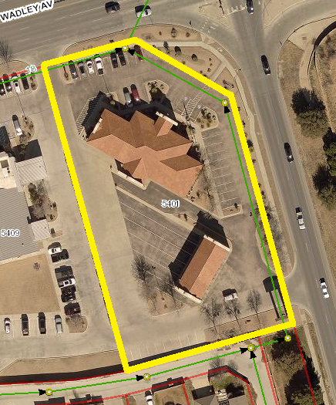
CURRENT COMMERCIAL TIER 4 EXAMPLE
5401 W. Wadley Ave.
West Texas National Bank
Approx. 55,478 impervious sf
Current fee: $68.40
14

Slide 15
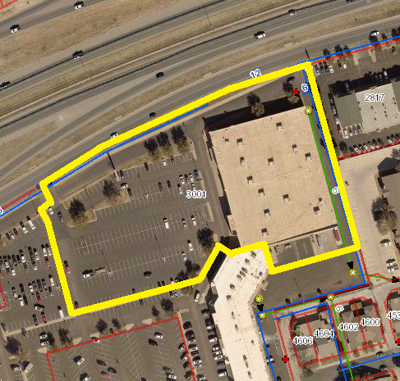
CURRENT COMMERCIAL TIER 5 EXAMPLE
3001 W. Loop 250
Burlington Coat Factory
Approx. 188,181
impervious sf
Current fee: $154.00
6

Slide 16
Exemptions
Among a sample of 50 Texas cities with stormwater fees:
10 exempted religious properties
28 exempted city properties
14 exempted county properties
19 exempted ISD properties
City | Religious Exempt | City Exempt | County Exempt | ISD Exempt
El Paso | No | No | No | Yes
Denton | No | No | No | No
Round Rock | No | Yes | Yes | Yes
Abilene | No | No | No | No
College Station | No | Yes | No | Yes
Mansfield | No | Yes | Yes | Yes
16
Notes:
Combine benchmark

Slide 17

Optional Exemptions
Revenue Not Collected Last Year Due to Optional Exemptions
MISD | CITY OF MIDLAND | MIDLAND COUNTY
$94,740 | $205,608 | $42,984
RELIGIOUS ORGANIZATIONS | STATE OF TEXAS | CEMETERIES
$108,480 | $14,820 | $4,488
Total: $471,120
17

Slide 18
2018 vs. 2025 Volumes
18

Slide 19

2018 vs. 2025 Revenue
19

